Slide 1
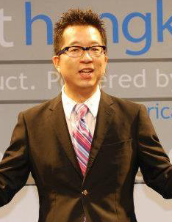
美安購物年金
THE SHOPPING ANNUITY
GAME CHANGER or NEW GAME?
Calvin Ip
顧問經理級經銷商 Supervising Coordinator
四個佣金週期共賺取HK$57,500
HK$57,500 in 4 Commission weeks
本簡報中提到的收入等級純屬舉例說明，無意代表美安香港經銷商的一般收入，也無意表示任何經銷商皆可賺取同等收入。美安香港經銷商的成功與否，取決於其在發展事業時的努力、才能與投入程度。The income levels mentioned in the following presentation are for illustration purposes only. They are not intended to represent the income of a typical Market Hong Kong Distributor, nor are they intended to represent that any given Independent Distributor will earn income in that amount. The success of any Market Hong Kong Independent Distributor will depend upon the amount of hard work, talent, and dedication which he or she devotes to building his or her Market Hong Kong Business.

Slide 2
美安購物年金
THE SHOPPING ANNUITY
GAME CHANGER or NEW GAME?
Notes:
9
11

Slide 3
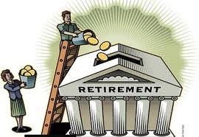
年金儲蓄 Annuity

Slide 4
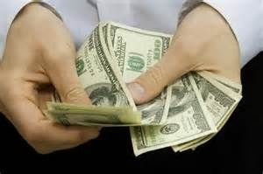
年金儲蓄 Annuity
一次性或定期供款
Lump sum or fixed installment
在指定日期後領取
Income after a fixed date
資產性收入
Asset income

Slide 6
娛樂
煙草產品
雜項
教育
醫療
現金捐贈
保險
退休金
交通
稅項
個人護理
送禮
衣服
食物
住屋

Slide 7
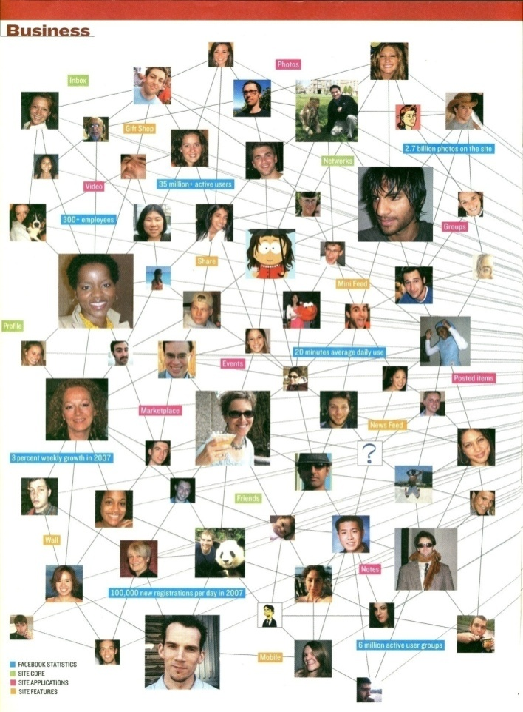
你的錢往哪裡去？ Where Does the Money Go?
＄
＄
＄
＄
＄
＄
＄
＄
＄
＄
＄
＄
＄
＄
＄
＄
Notes:
先說明，消費必定產生利潤，只是誰賺走的問題。
大多數的利潤都落入少數財團的口袋中─
要以7-11、家樂福、百貨公司消費為例說明。

Slide 8
到底在哪裡能把消費轉為投資
為我們日常的購物省錢
同時帶來收入？
“Turn spending into earning: Savings and convert shopping into income!”
Where else can you do this?
Notes:
8

Slide 9
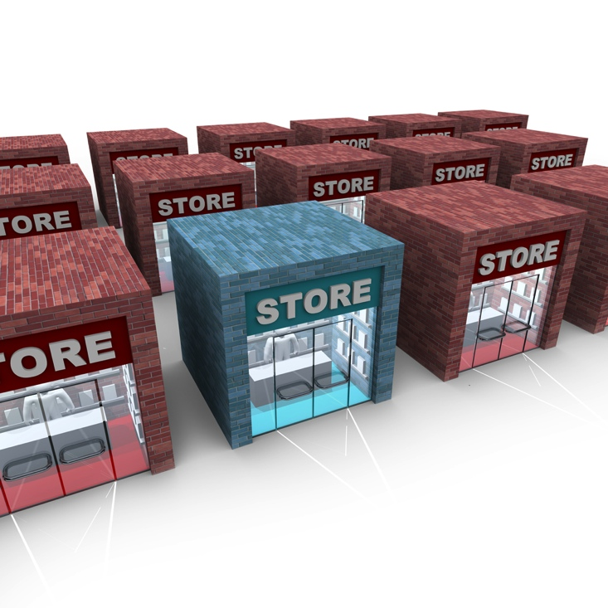
BRICK AND MORTAR
Brick and Mortar 傳統消費

Slide 10
Click and Order 改變消費習慣

Slide 11
美安香港優勢
How do we put it all together?
系統跟進消費
Tracking System to track all orders
每人都想節省金錢
People have less $,
NO $ to Save or Invest
所有人生活都要購物/消費(勒緊褲頭)
方便購物體驗
Automation Program to find what you are buying
People must SHOP /Spend to Live
(Tighten Belt)
提供更佳產品及優惠
We provide Shopping & Savings for everyone
MA Products to Brick and Mortar, Savings Better
改變消費習慣
Brick and Mortar to Click and Order

Slide 12
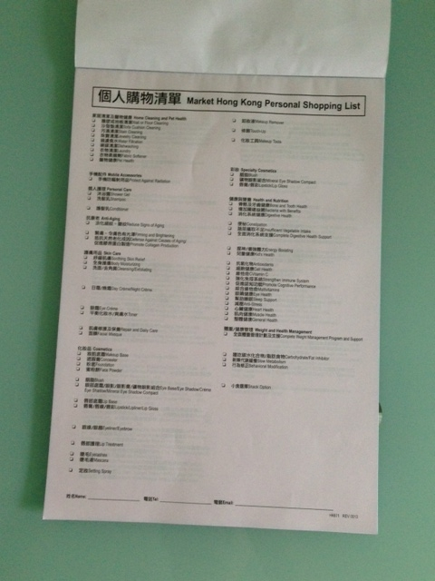
精明
消費轉成投資
Spending to Earning
家居購物清單
Home Shopping List

Slide 13
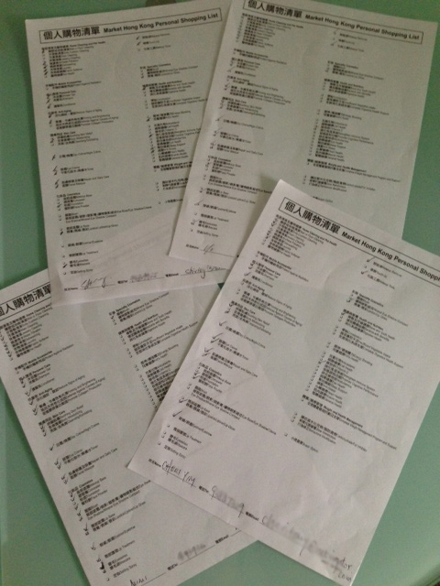
利用家居購物清單 Use the Home Shopping List
和朋友夥伴分享
Share with Partners and Friends
提供購物建議
Shopping Suggestions

Slide 14
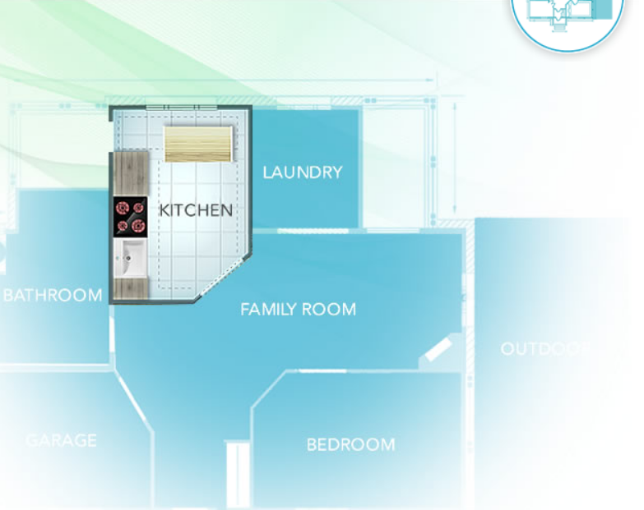
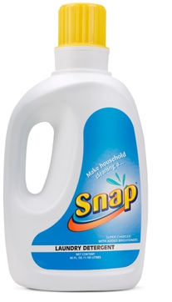
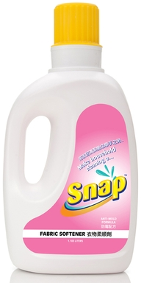
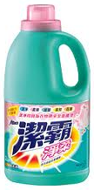
Snap
抗菌洗潔精
Dishwashing
Liquid
Snap
洗衣液
Laundry
Detergent
Snap
衣物柔順劑
Fabric Softener
Snap
萬用清潔劑
Multi-purpose Natural Concentrate
洗碗液
Dishwashing Detergent
洗衣液
Laundry
Detergent
柔順劑
Fabric
Softener
清潔劑
Cleaner
22 BV

Slide 15
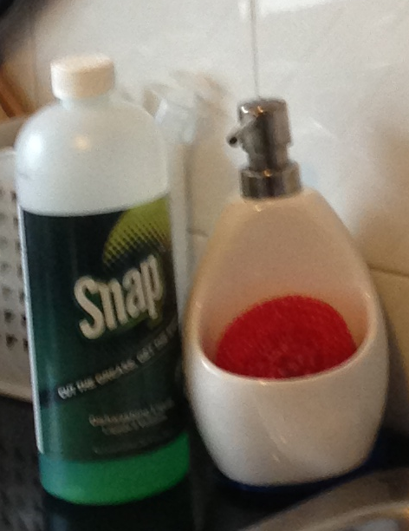
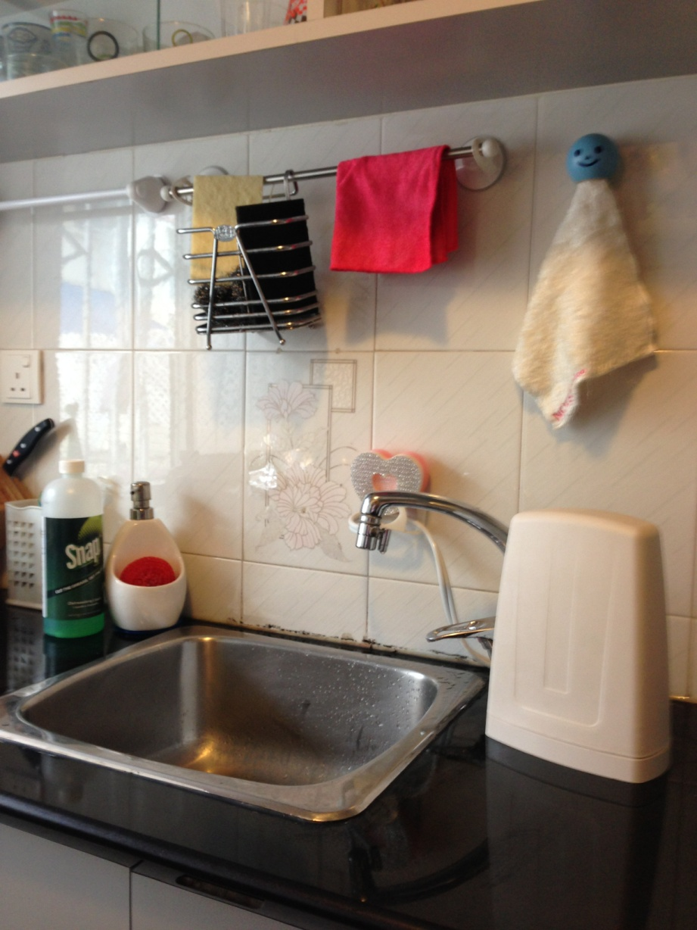
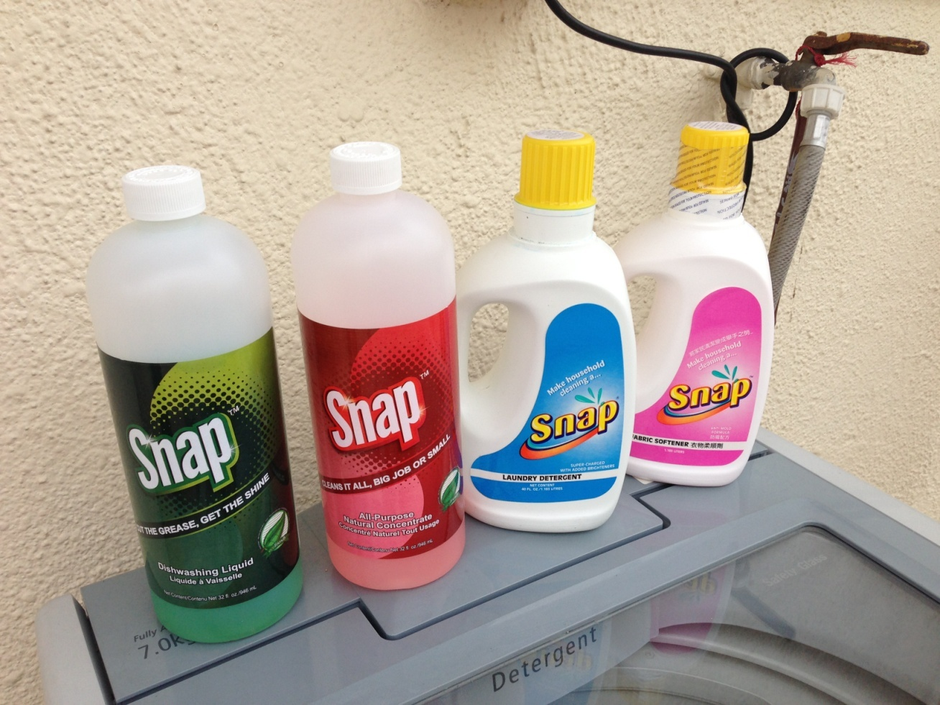
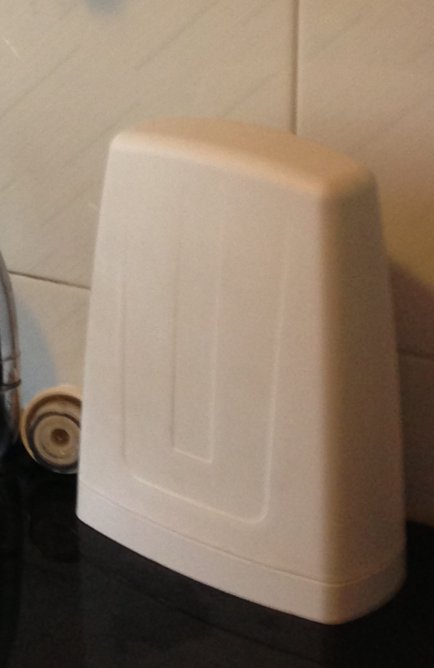
美安家居 mhk Household

Slide 16
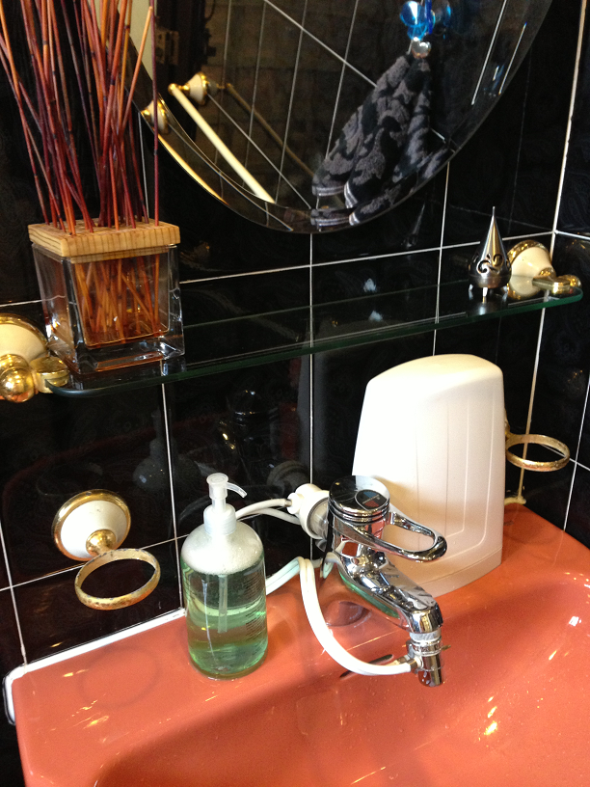
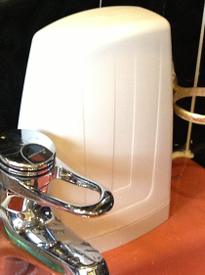
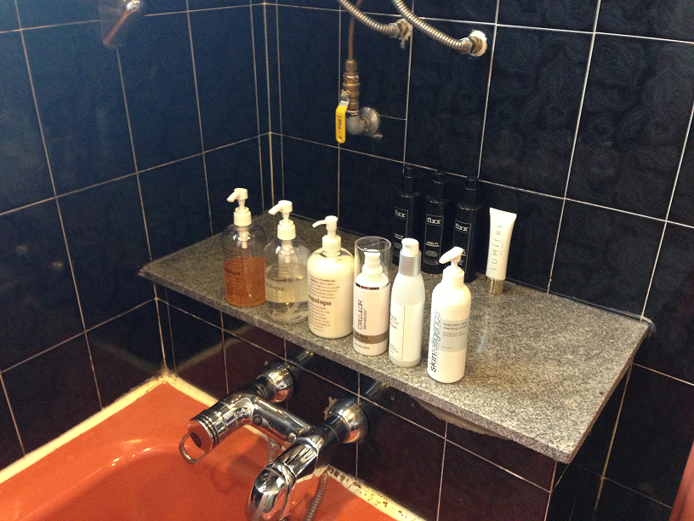
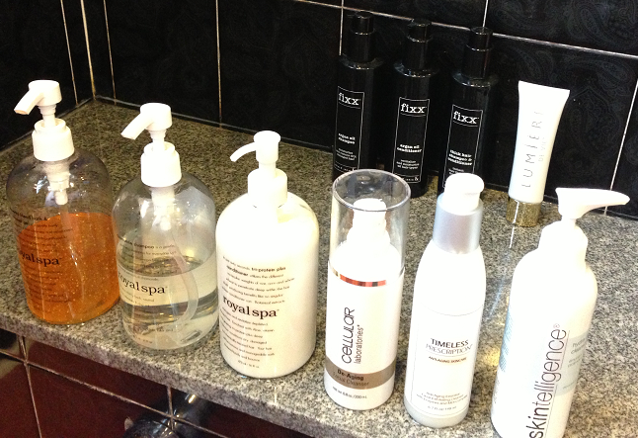
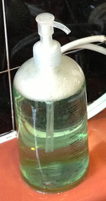
美安家居 mhk Household

Slide 17
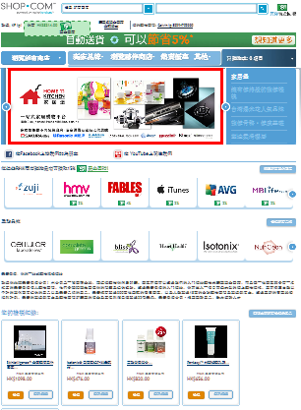

Slide 18
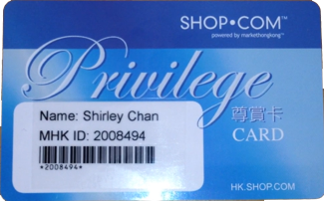
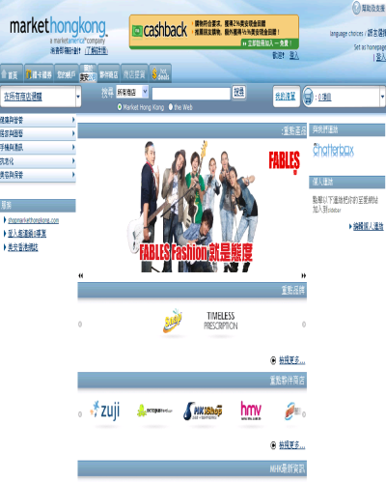
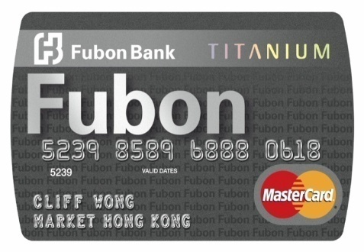
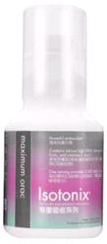
各項優惠 Deals Offered
現金回贈／邀請朋友
Cashback / Invite Friends
2
$
$
1
優惠顧客尊賞卡
Privilege Card
$
美安(IBV)產品
MHK(IBV) Products
$
4
3
香港／富邦Titanium萬事達卡
mhk/Fubon Titanium MasterCard
獨家代理產品
Exclusive Products
Notes:
Nora is the 1st IBV earner, why you can earn the cheque so easy?
Nora : IBV = BV = Bank Account = $
BV=IBV

Slide 19
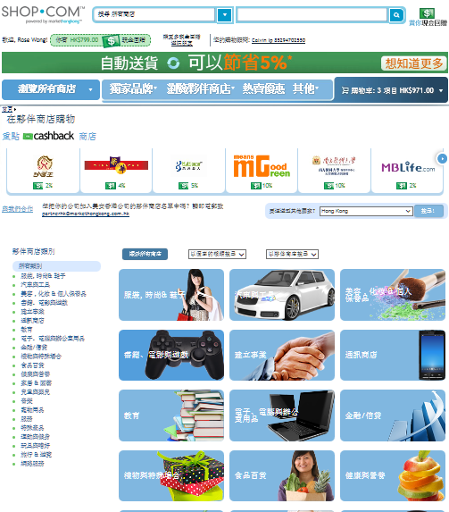
More Shopping Annuity - IBV 更多的購物年金 - IBV
食品
Food
文具
Stationary
電子產品
Electronics
服飾及鞋類
Apparel
旅行及遊覽
Travel
家居用品
Home Care
消閒娛樂Entertainments
兒童用品
Child Products

Slide 20
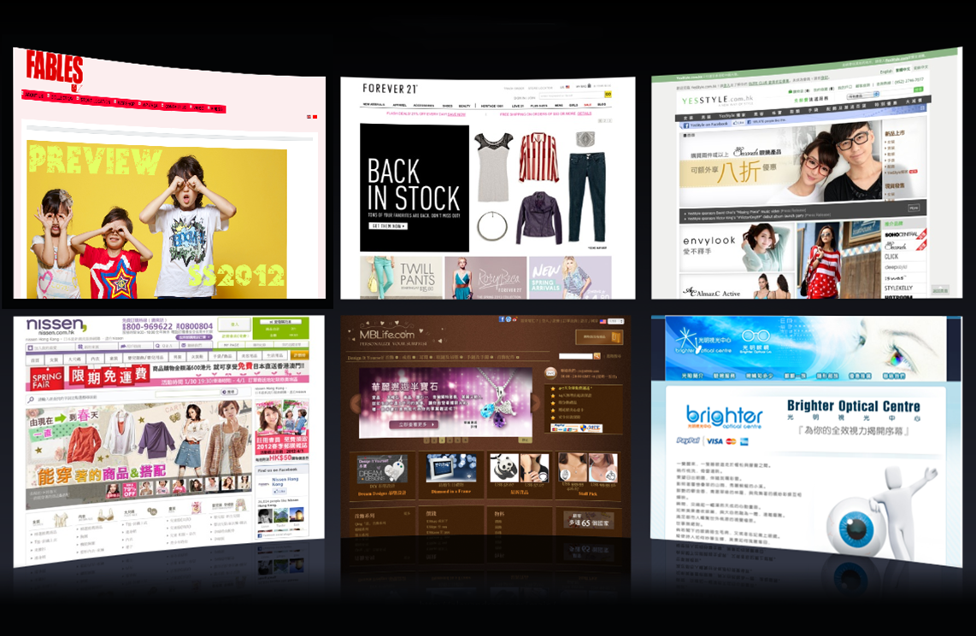
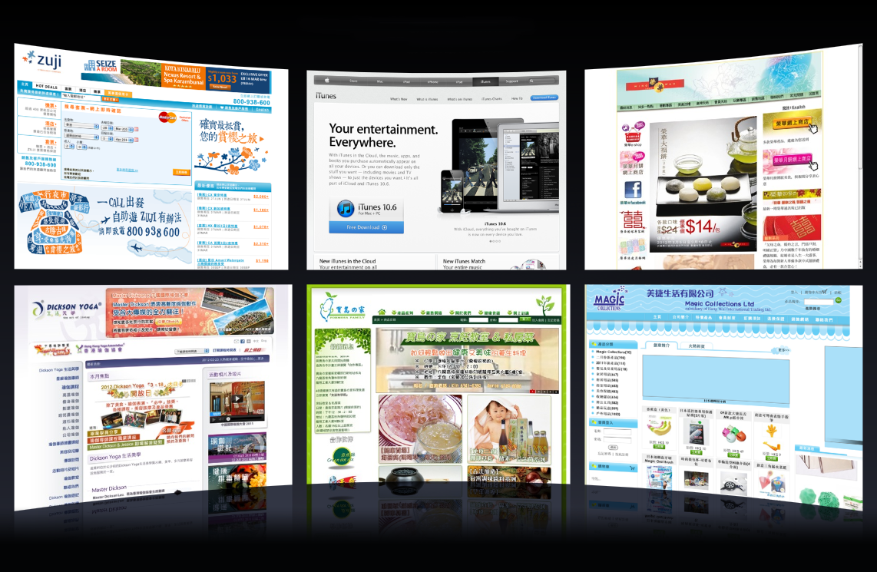
夥伴商店
Partner Stores
夥伴商店
Partner Stores
夥伴商店
Partner Stores
夥伴商店
Partner Stores

Slide 21
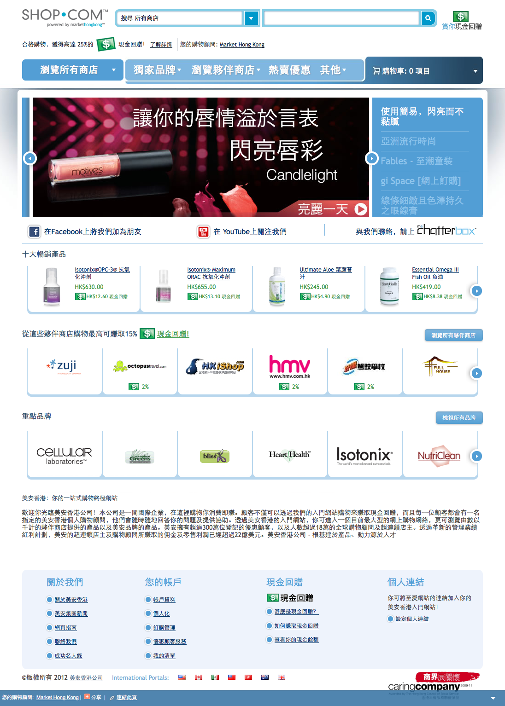
熱門優惠
Hot Deals
數百項美安獨家品牌產品
Hundreds of Exclusive markethongkong™ Brands
社交網絡
Social Networking
購買美安品牌的產品和上有現金回贈圖示的夥伴商店產品，賺取高達25%的現金回贈。
Earn up to 25 percent cash back for purchasing mhk branded products and those from our Partner Stores where you see the Cashback logo
推薦他人購物，從被推薦人的消費中賺取0.5%的現金回贈。
Earn ½ percent on eligible referral purchases

Slide 22
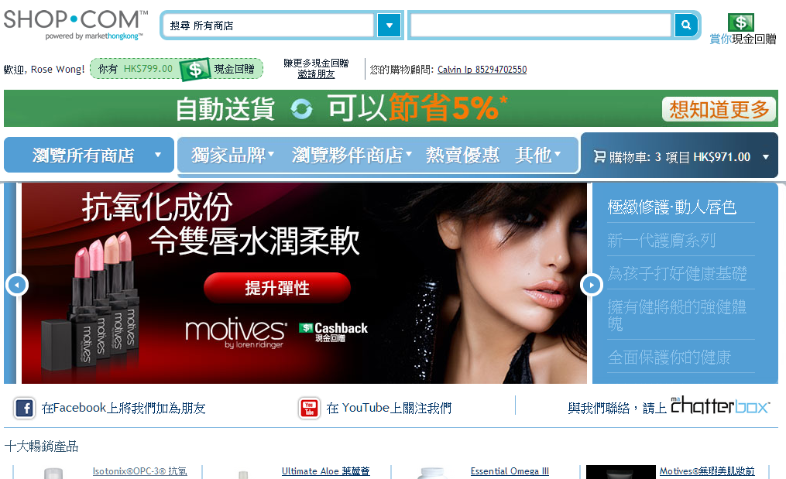
美安現金回贈

Slide 23
節省更多 賺得更多 Save More, Earn More
購買美安品牌產品和上有現金回贈圖示的夥伴商店產品，賺取高達25%的現金回贈
現金回贈綜合儲蓄
Earn up to 25 percent cash back for purchasing mhk branded products and those from our Partner Stores where you see the Cashback logo
Save Spending all together with Cashback

Slide 24
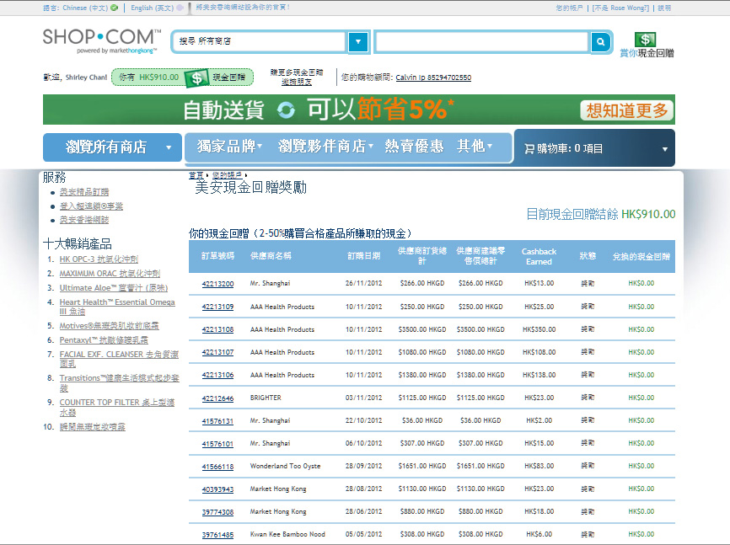
Your current Cashback balance HK$902.00

Slide 25
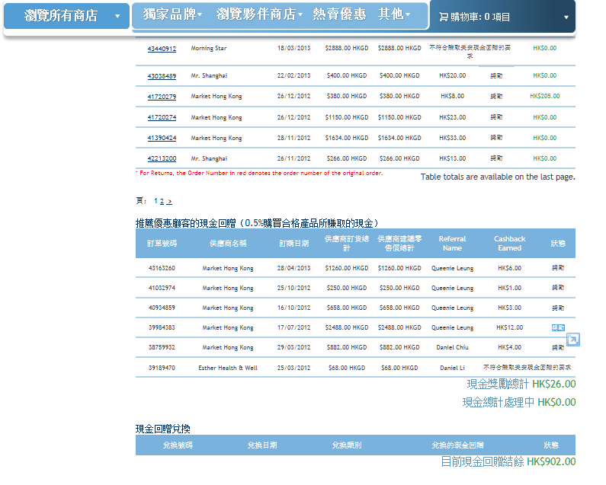
Cashback on referral of Preferred Customers
(0.5% Cashback for every qualified purchase)

Slide 26
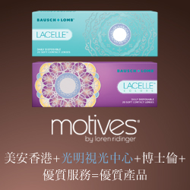
My Typical Day 一天消費
2% Cashback
外出用餐 $70
Dining out
糧油食品 $88
Groceries
眼鏡 $139
Glasses
訂購名片 $115
Name cards
美食禮品 $120
Gift Sets
5% Cashback
2% Cashback
$532
3% Cashback
$20
6% Cashback

Slide 27
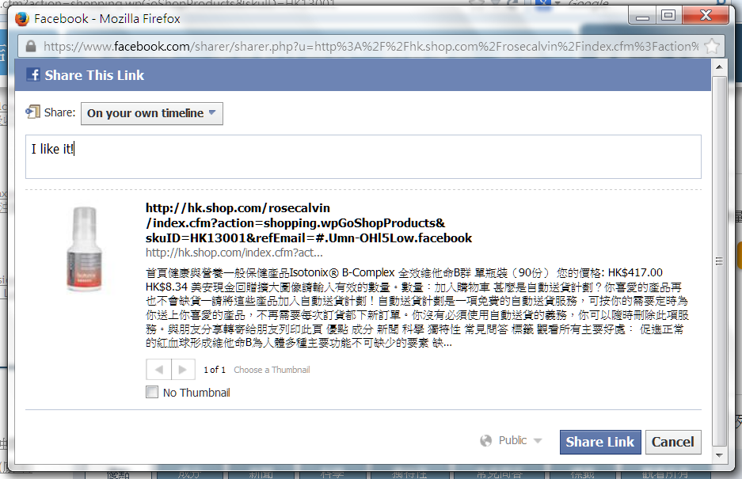
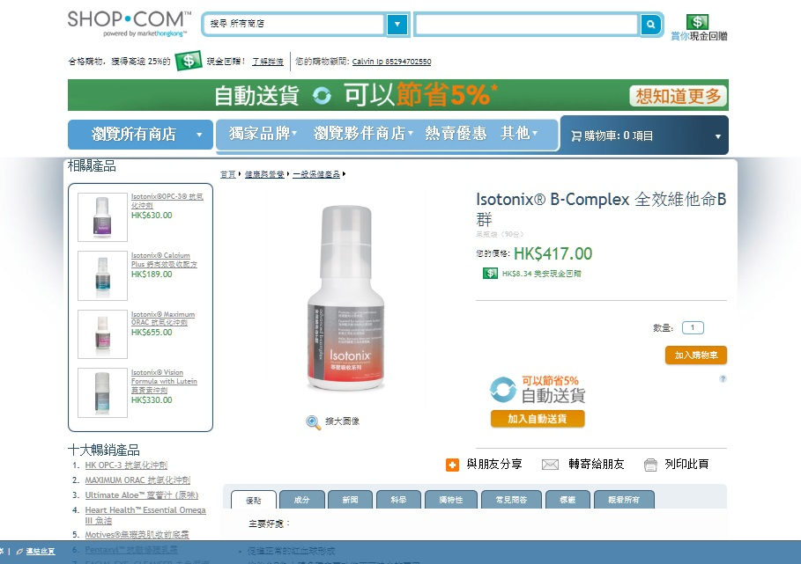
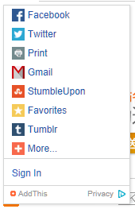
Social Shopping 社交購物分享

Slide 28
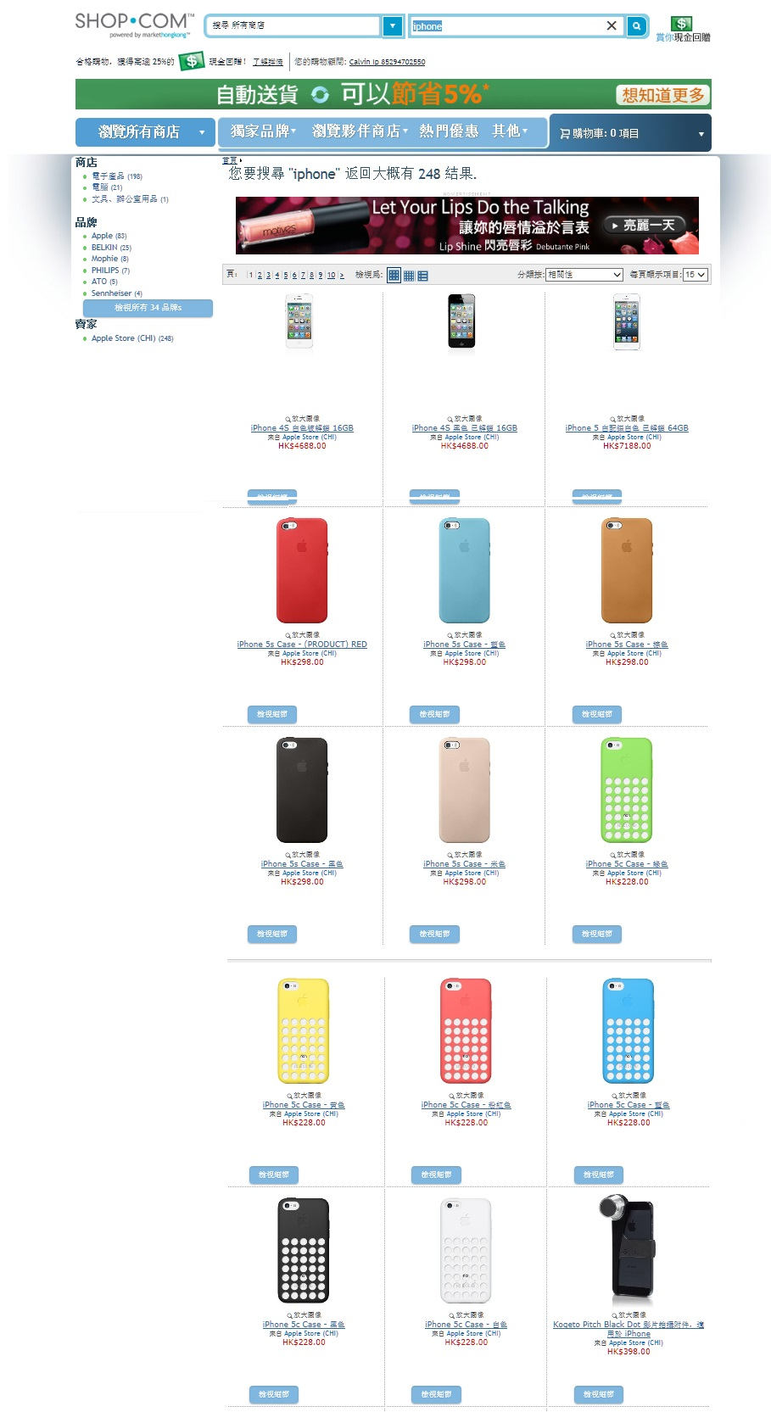
Product Search 產品搜尋

Slide 29
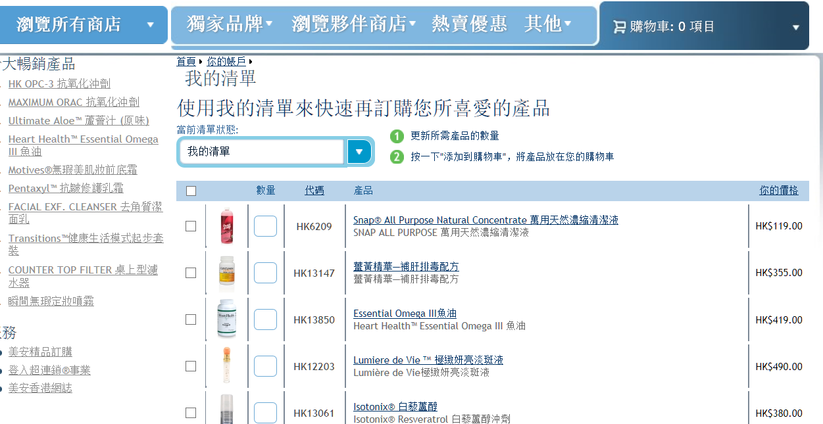

Slide 30
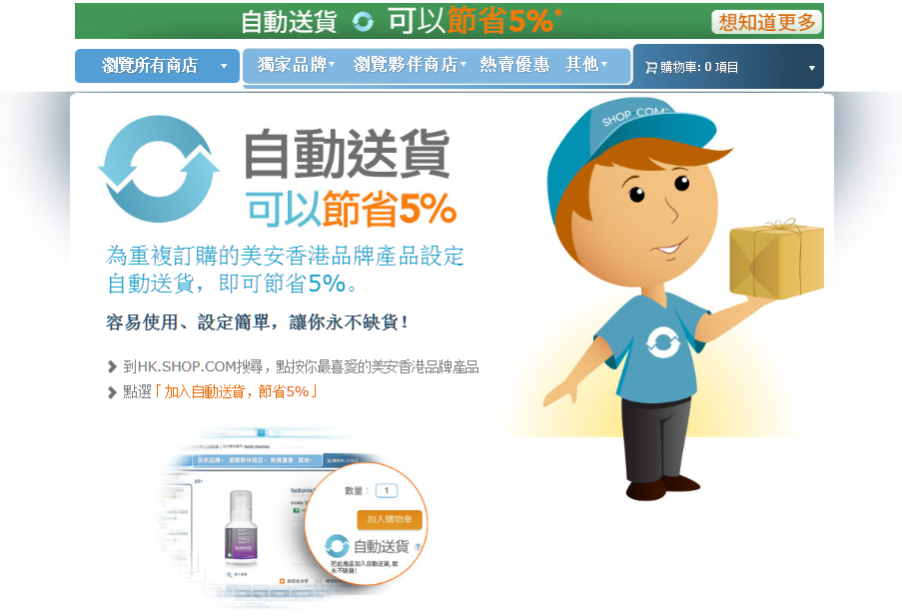

Slide 31
BV/IBV

Slide 33
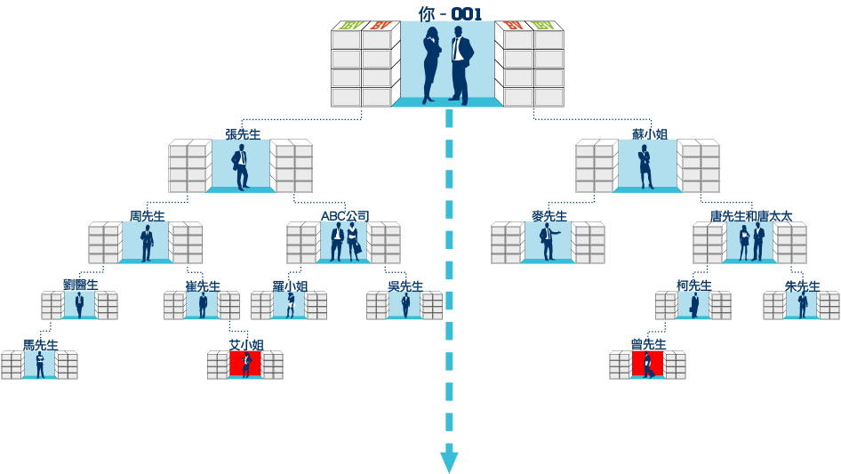
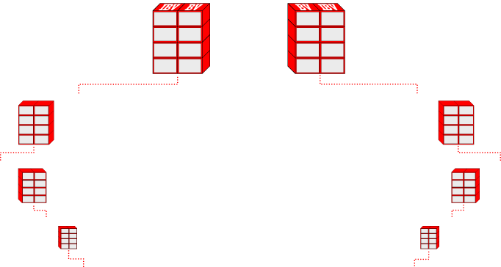
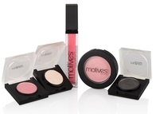
THE SYSTEM SEARCHES FOR BV & IBV TO INFINITY
零售、擴大分銷、優惠顧客透過你的入門網站訂購、購買產品自用與以口碑相傳方式宣傳
Retail sales, expanding distribution, preferred customers ordering through your website, personal use and word-of-mouth advertising
System Search
System Search

Slide 34
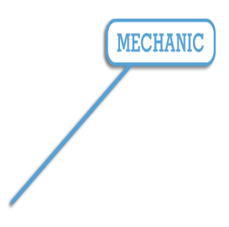
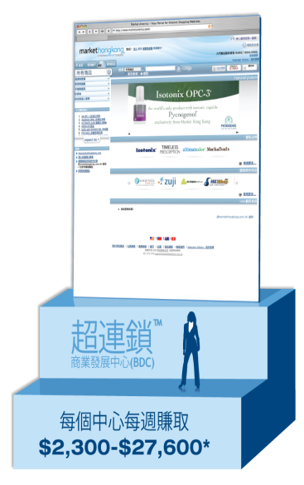
BV/IBV
$$$$
回贈
10,000 位超鎖所店主
10,000 UFOs
100,000 位優惠顧客
100,000 PCs

Slide 35
美安購物年金：
Shopping Annuity is about:
社群經濟的重複消費
帶來永續性收入
Regenerated volume in a monetized community producing residual income.
Notes:
35

Slide 36
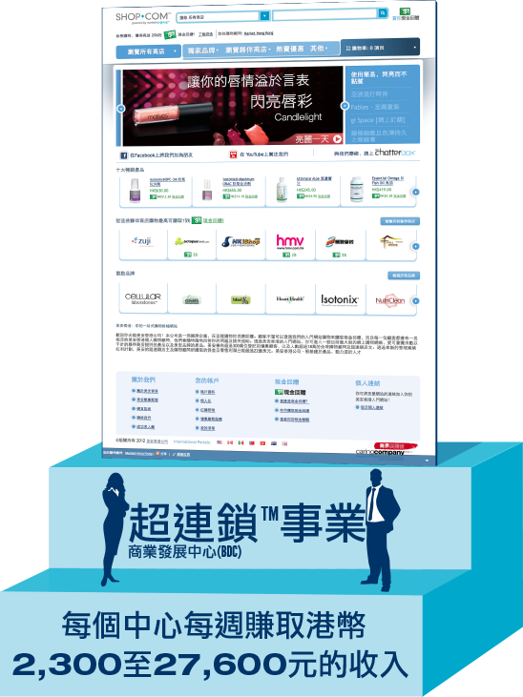
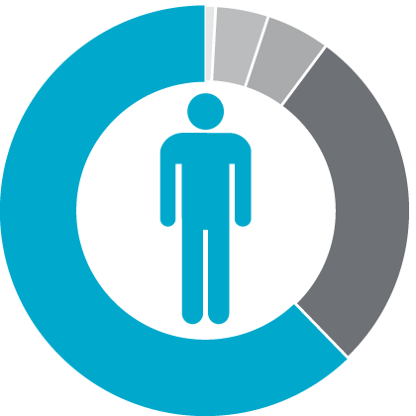
Which would you prefer?
UnFranchiseTM Business Development Center (BDC)
Earn HK$2,300 to $27,600 per week per BDC
45年計劃
45 Year Plan
2到3年計劃
2 to 3 Year Plan

Slide 37
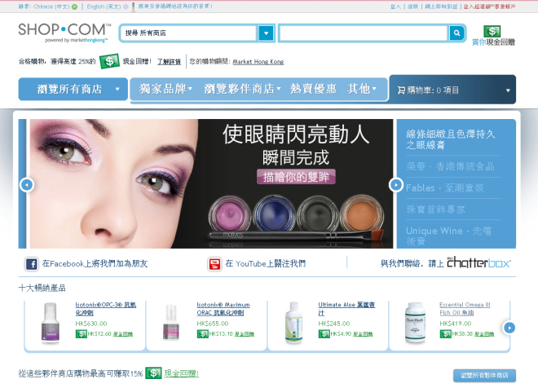
MPCP
- $$$
BV / IBV
購物年金 - 精明消費 作出選擇
把消費轉成投資 賺取永續性收入
Shopping Annuity - Shop Smart
Turn Spending into Residual Income

